Slide 1



1
Designed for Tomorrow, Delivered Today
Notes:
“Last mile” refers to the final leg of a delivery’s journey—from the local distribution hub (or micro-fulfillment center) all the way to the customer’s doorstep In supply-chain terms, it’s that last segment—often just a few miles or even blocks—but paradoxically it’s the most complex and costly part of the whole route.
In our autonomous-robot context, “last-mile delivery” is exactly the slice we’re automating: instead of a van or part time delivery worker handling that final trip, our robot handles it—navigating sidewalks, bike lanes, building entrances, etc.—to cut the >50 % of total shipping cost that typically lives in this very segment.

Slide 2







8
Transforming last mile delivery into a low-risk, high ROI, and climate-positive service
Reducing 90% drop in carbon footprint, 80% cuts in energy demand and 70% cuts on unit delivery cost.
Clean Moves, Clean Mission
Notes:
Why It Matters
Speed: 20-30 min deliveries vs. 2–3 hr for vans
Cost: 70% lower per-mile expense than gig-drivers
Sustainability: 98% CO₂ cut, aligning with Sweden’s net-zero goals
SDG 7: Affordable and Clean Energy Goal: Ensure access to affordable, reliable, sustainable and modern energy for all. Sustainable Development Goals ADR impact: By cutting per-mile energy use from ~2.5 kWh to ~0.5 kWh (80 % reduction), ADR fleets shrink electricity demand and ease pressure on grids—enabling last-mile delivery on low-power, renewable-friendly outlets rather than heavy-duty chargers. Nature
SDG 9: Industry, Innovation and Infrastructure Goal: Build resilient infrastructure, promote inclusive and sustainable industrialization and foster innovation. Sustainable Development Goals ADR impact: ADRs represent a leap in smart urban infrastructure—integrating AI-driven routing, edge computing and vision-only navigation to create a scalable, low-cost delivery network. This both modernizes logistics “roads” and spurs new robotics industries. Nature
SDG 11: Sustainable Cities and Communities Goal: Make cities and human settlements inclusive, safe, resilient and sustainable. Sustainable Development Goals ADR impact: By shifting dozens of van trips to silent, sidewalk-friendly robots, ADRs reduce congestion, free up curb space, and cut noise and safety hazards—directly improving urban liveability. MAPFRE
SDG 12: Responsible Consumption and Production Goal: Ensure sustainable consumption and production patterns. Sustainable Development Goals ADR impact: Optimized routing and high utilization drive down wasted miles and failed deliveries. Fewer return trips and less packaging damage mean leaner resource use per parcel. Nature
SDG 13: Climate Action Goal: Take urgent action to combat climate change and its impacts. Sustainable Development Goals ADR impact: Cutting CO₂e from ~0.59 kg/mile to ~0.01 kg/mile (≈98 % reduction) slashes delivery-related emissions, aligning last-mile logistics with Sweden’s net-zero targets. Nature
Together, these contributions show that ADRs are not just a commercial innovation—they’re a lever for multiple SDGs, turning every delivery into progress on energy, infrastructure, cities, consumption and climate.

Slide 3

5
Costly, Slow, Unreliable: The Last-Mile Crisis
Problem 1:
Grocery shopping can be a hassle
Time-consuming trips, carrying and handling and inventory uncertainty.
74.6%-Consider delivery charges to be expensive
90% people prefer shopping online and currently, 63.5% of people order online
87.3 % would order online if it were cheaper and convenient (+ 24%)
Problem 2:
Hiring part timers for supermarkets consumes a lot of resources.
Recruitment Overhead: Long and hectic hiring processes
Increased Cost: High Cost for Part-time and other delivery jobs
Scheduling Complexity: Creating their schedules and assigning tasks
Training and Turnover Cost: Due to part-time work there is a lot of turn over and therefore, requiring constant training
Foodora:180/hr
Squarebot: 40/hr
Notes:
Removing the long and hectic hiring processes
Increasing profitability for businesses through cost cutting; Foodora 180/hr – Squarebot: 40-50/hr (Bring the cost down to a whooping ≈72-78%); 78% less; SEK140 less

Slide 4
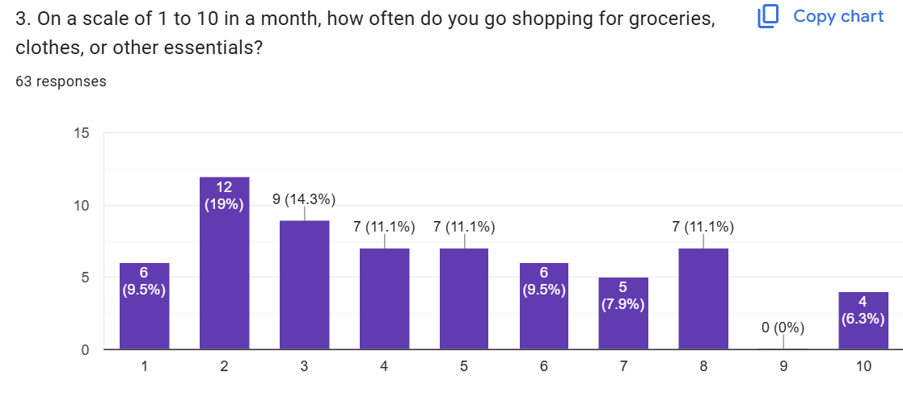
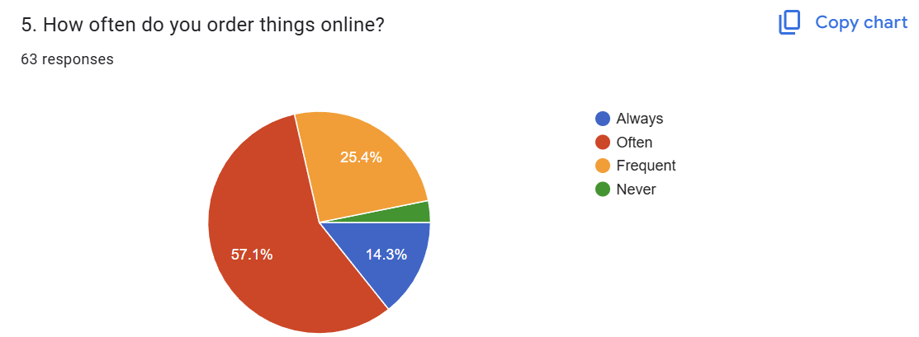
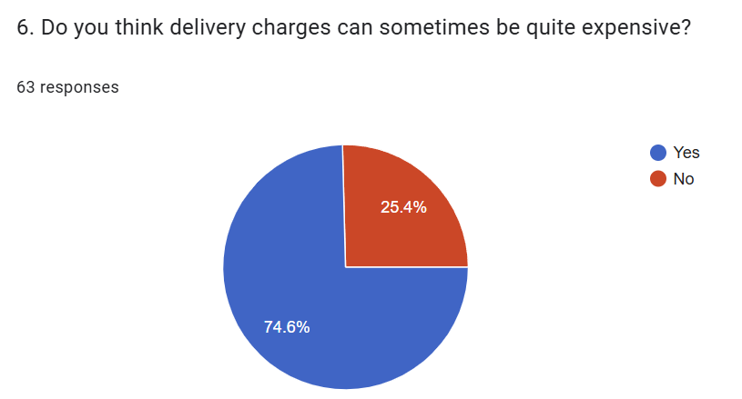
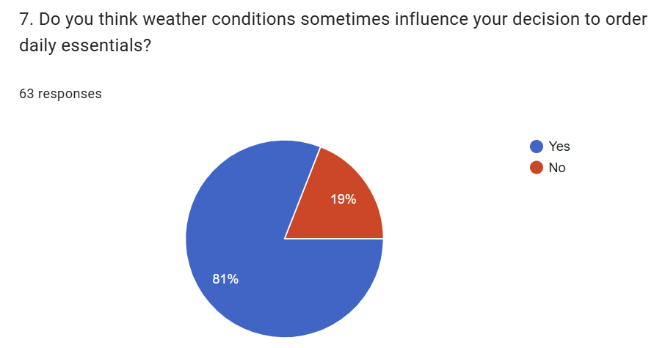
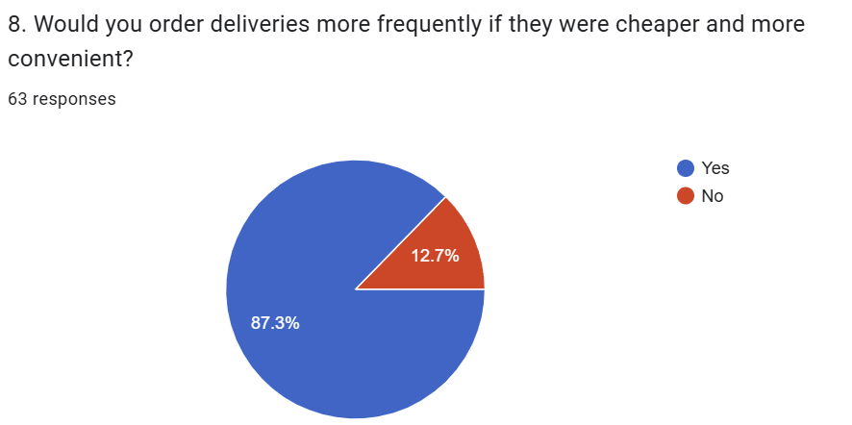
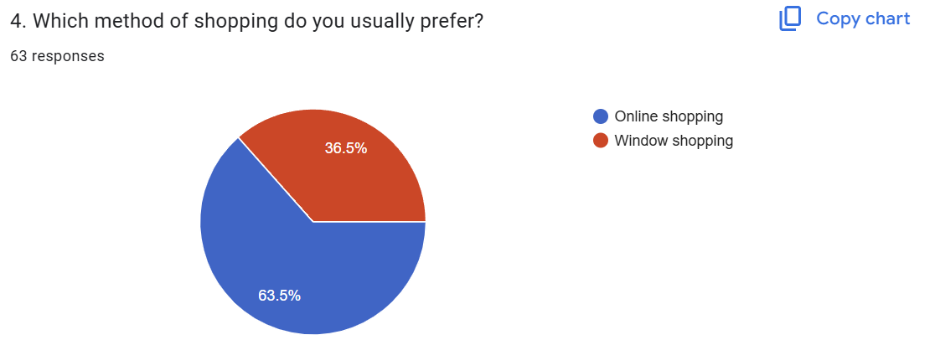
15
Customer Validation

Slide 5
Autonomous Delivery Robots (ADR)
8
AI-powered, vision-only robots that navigate sidewalks, bike lanes and building entrances. Modular design supporting grocery, parcel and food delivery with secure compartments.
Feature | Benefit
12-camera 360° vision system | High-precision obstacle avoidance at a fraction of LiDAR cost
AI-driven route optimization; Grid Style Path Planning | Dynamic re-routing around pedestrians, weather & congestion
Secure app/QR access | Touchless customer handoff with real-time tracking
All-electric drivebot | Zero emissions; Nordic climate–tested down to –25 °C
Notes:
Why It Matters
Speed: 20-30 min deliveries vs. 2–3 hr for vans
Cost: 70% lower per-mile expense than gig-drivers
Sustainability: 98% CO₂ cut, aligning with Sweden’s net-zero goals
SDG 7: Affordable and Clean Energy Goal: Ensure access to affordable, reliable, sustainable and modern energy for all. Sustainable Development Goals ADR impact: By cutting per-mile energy use from ~2.5 kWh to ~0.5 kWh (80 % reduction), ADR fleets shrink electricity demand and ease pressure on grids—enabling last-mile delivery on low-power, renewable-friendly outlets rather than heavy-duty chargers. Nature
SDG 9: Industry, Innovation and Infrastructure Goal: Build resilient infrastructure, promote inclusive and sustainable industrialization and foster innovation. Sustainable Development Goals ADR impact: ADRs represent a leap in smart urban infrastructure—integrating AI-driven routing, edge computing and vision-only navigation to create a scalable, low-cost delivery network. This both modernizes logistics “roads” and spurs new robotics industries. Nature
SDG 11: Sustainable Cities and Communities Goal: Make cities and human settlements inclusive, safe, resilient and sustainable. Sustainable Development Goals ADR impact: By shifting dozens of van trips to silent, sidewalk-friendly robots, ADRs reduce congestion, free up curb space, and cut noise and safety hazards—directly improving urban liveability. MAPFRE
SDG 12: Responsible Consumption and Production Goal: Ensure sustainable consumption and production patterns. Sustainable Development Goals ADR impact: Optimized routing and high utilization drive down wasted miles and failed deliveries. Fewer return trips and less packaging damage mean leaner resource use per parcel. Nature
SDG 13: Climate Action Goal: Take urgent action to combat climate change and its impacts. Sustainable Development Goals ADR impact: Cutting CO₂e from ~0.59 kg/mile to ~0.01 kg/mile (≈98 % reduction) slashes delivery-related emissions, aligning last-mile logistics with Sweden’s net-zero targets. Nature
Together, these contributions show that ADRs are not just a commercial innovation—they’re a lever for multiple SDGs, turning every delivery into progress on energy, infrastructure, cities, consumption and climate.

Slide 6
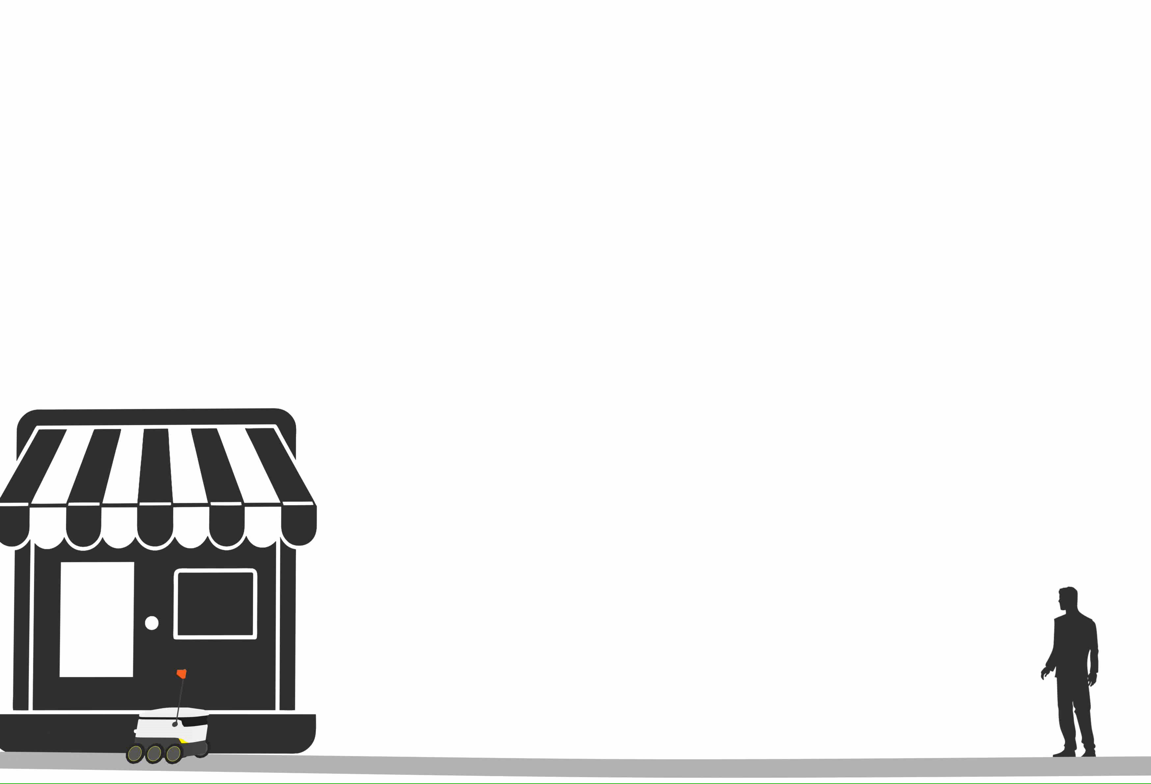

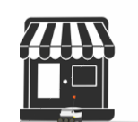
Autonomous Delivery Robots (ADR) – Proposition
10
1. Business - Customer Delivery B2C
2. Customer - Customer Delivery – C2C
3. Business – Business Delivery – B2B
Notes:
Segment Value Proposition
Customer-to-Customer (C2C)“Send anything, anywhere—robotically. 24/7 secure, on-demand deliveries between neighbors at just SEK 15 per drop.”Delivery time ≤30 min; cost SEK 15; NPS ≥ 50
Business-to-Business (B2B)“Automate your last-mile: cut delivery costs by 70 %, guarantee 95 % uptime, and integrate seamlessly into your WMS via our API.”Cost/mile SEK 1.50; uptime ≥ 95 %; integration time ≤ 2 weeks
Business-to-Customer (B2C)“Delight your shoppers with same-hour grocery & parcel delivery—green, reliable, and app-driven for ultimate convenience. ”Repeat rate ≥ 40 %; CO₂/mile ≤ 0.01 kg; delivery in 30 min
Additional Revenue Streams
Data-as-a-Service
Sell anonymized route, traffic, and consumer-behavior insights to city planners, retailers, and logistics firms.
In-Bot Advertising & Sponsorship
Digital screens on robots display hyper-local ads; revenue shared with retail partners.
Software Licensing & White-Labeling
License the grid-planning and fleet-management platform to other robot OEMs or large logistics providers.
Premium Service Tiers
Offer guaranteed <15 min delivery or temperature-controlled compartments (cold chain) at a surcharge.
Maintenance & Training Packages
Upsell annual maintenance contracts, spare-parts kits, and on-site operator training for third-party fleets.

Slide 7
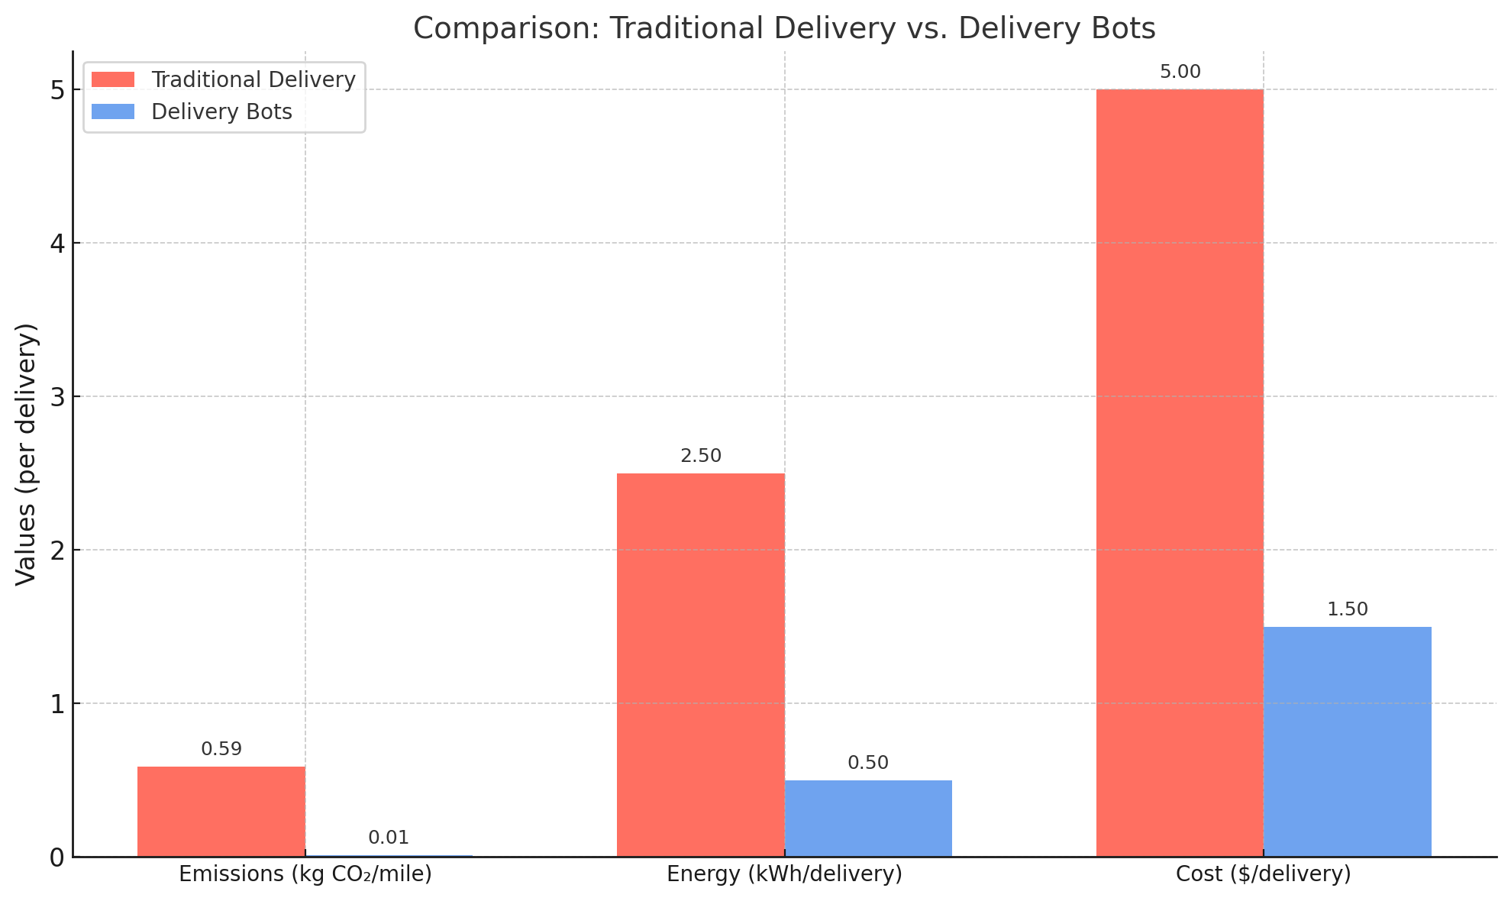
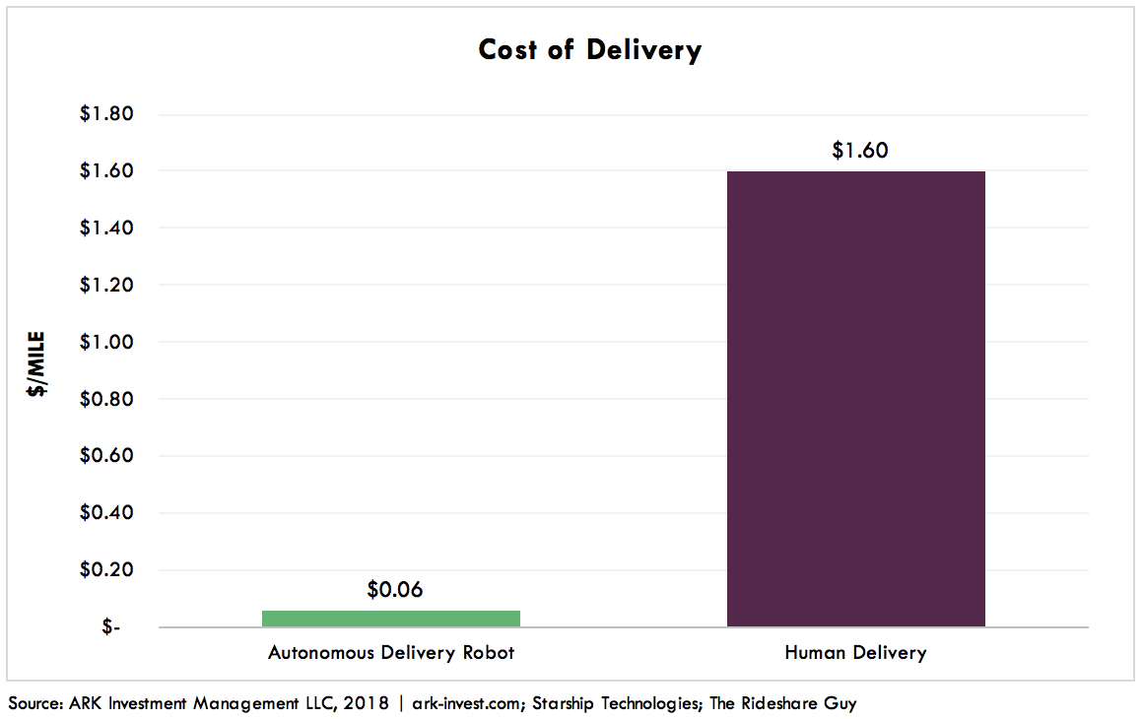
Traditional vs New Normal; aka Square
11
Autonomous-robot deliveries make sense because they turn an expensive, carbon-heavy, energy-hungry process into a near zero-cost, zero-emission service.
Square: Swift, Cost-Efficient & Sustainable
Notes:
Autonomous-robot deliveries make sense because they turn an expensive, carbon-heavy, energy-hungry process into a near-zero-cost, zero-emission service. In brief:
Cost collapse
Human delivery costs run around $1.60 per mile; robots can do it for $0.06—over a 96 % reduction in per-mile spend.
Energy efficiency
Conventional last-mile uses ~2.5 kWh per delivery; robots use only 0.5 kWh—a 80 % cut in energy demand.
Climate win
Emissions fall from ~0.59 kg CO₂/mi to ~0.01 kg CO₂/mi—a 98 % drop, turning every delivery into a green action.
Together, these advantages justify replacing vans and gig-workers for short-range “last-mile” runs: you save money, slash energy use, and meet climate goals all at once—delivering both profit and sustainability.

Slide 8
Business Model-Diversified, Predictable & Scalable
25
Stream | Description | Unit Economics
Robot Leasing | Monthly rental of ADR hardware (incl. maintenance & SW updates) | 10,000 SEK/month/-
Per-Delivery Fee | Usage-based charge per trip, billed to retailer or end-user | 8– 13 SEK/mile (vs. 19–24 SEK competitor)
Annual Maintenance Contract | AMC covering spare parts, software upgrades, on-site support | 10-20 % of robot cost ⇒ 5 000 –10 000 SEK/yr
Software Subscription (SaaS) | Fleet management dashboard, analytics API, route-optimization | 500 SEK/bot mo ⇒ 6 000 SEK/bot yr
In-Bot Advertising | Digital display ads on robots; geo-targeted to neighborhoods | 1 000 SEK/bot month ad revenue potential

Slide 9
Cost Breakdown
Item | Value (SEK)
CapEx (build cost) | 50 000 – 70 000
Monthly Revenue – Leasing | 10 000
Monthly Revenue – SaaS | 500
Total Revenue (monthly) | 10 500
Total Revenue (annual) | 126 000
Annual AMC (mid-point) | 7 500
Total 1st-Year Revenue per Bot | 133 500
Cost of Service (energy, ops) | 6 000
Personnel Cost (4 FTE) | 240 000 /mo 2 880 000 /yr
Personnel cost allocated per bot | 7 500 /mo
Gross Profit per Bot (monthly, incl. personnel & ops) | 2 500 /mo
Gross Profit per Bot (annual, incl. personnel & ops) | 30 000 /yr
Gross Profit on 32 Bots (annual, incl. personnel & ops) | 360 000/yr
Gross Margin (incl. personnel) | ≈ 24 %
Notes:
AMC: robot ensures reliability, uptime guarantees, and steady post-sale revenue.
Example:
Consider:
Lidl - 5
ICA – 5
Hemkop – 5
COOP – 5
Willys – 6
As per the calculation showed above
26*18000
Total Earnings – 4,68,000
Remove Expenses - ~3,00,000
Profit – 1,68,000

Slide 10

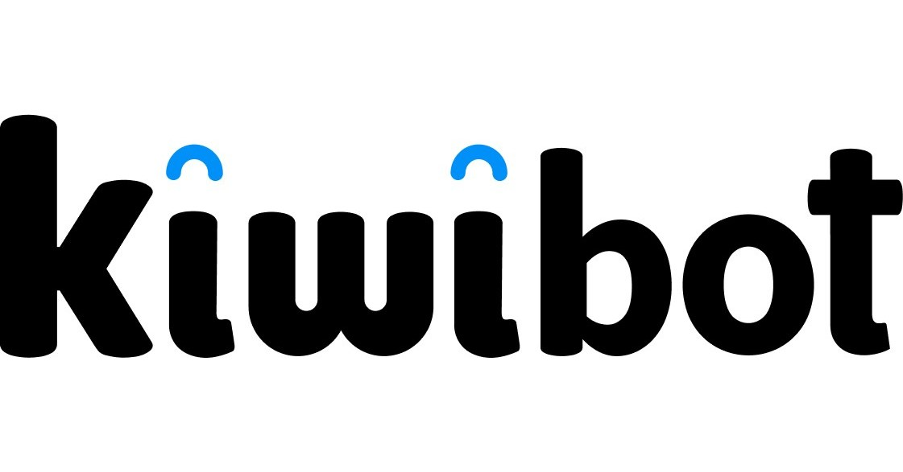

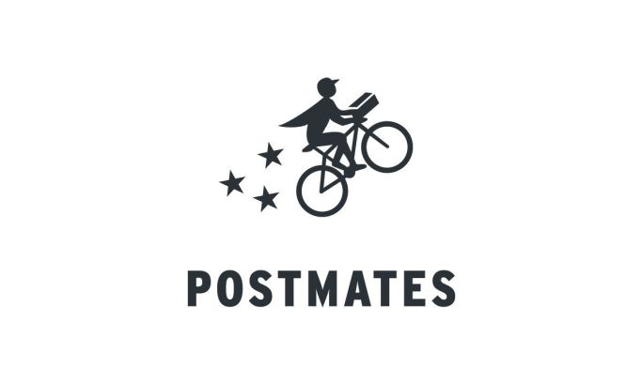
Competitor Analysis
Competitor | Cost per Mile (SEK) | Navigation Tech | Scalability | Reliability/Uptime | Nordic-Ready | Key Weakness
Starship | 10 – 15 SEK | LiDAR + GPS | Medium (limited fleet density) | ~90% | No (not winter-hardened) | High hardware cost; struggles in snow
Kiwi | 12 – 17 SEK | LiDAR + stereo vision | Low–Medium | ~88% | No | Costly sensors; limited urban tests
Nuro | 24 – 29 SEK | Radar + LiDAR | Low (vehicle-scale, regulatory barriers) | ~92% | No | Regulatory complexity; high capex
Postmates | 19 – 24 SEK | Human navigation | High (gig-economy) | ~80% | N/A (human) | Labor-intensive; inconsistent service
Square | 8 – 13 SEK | 12-camera vision-only + LiDAR + GPS | High (grid-planning + fleet AI) | ~92%-~95% | Yes (–20 °C anticipated) | New entrant; needs pilot data
Notes:
Cost, Performance & Market Fit: Square
Cost per Mile: ADR undercuts all robotic (70–80% lower) and human-driver options (80% lower than Postmates).
Navigation Tech: Vision-only versus expensive LiDAR/radar—lowers BOM cost and energy demand.
Scalability: Grid-style planning + cloud-coordinated fleet management allows high‐density deployment vs. sparse LiDAR fleets.
Reliability/Uptime: Target ≥95% through redundant cameras and edge compute, exceeding competitors’ ~88–92%.
Nordic-Ready: ADR is the only system climate-hardened for snow, ice, subzero—critical for Swedish roll-out.

Slide 11
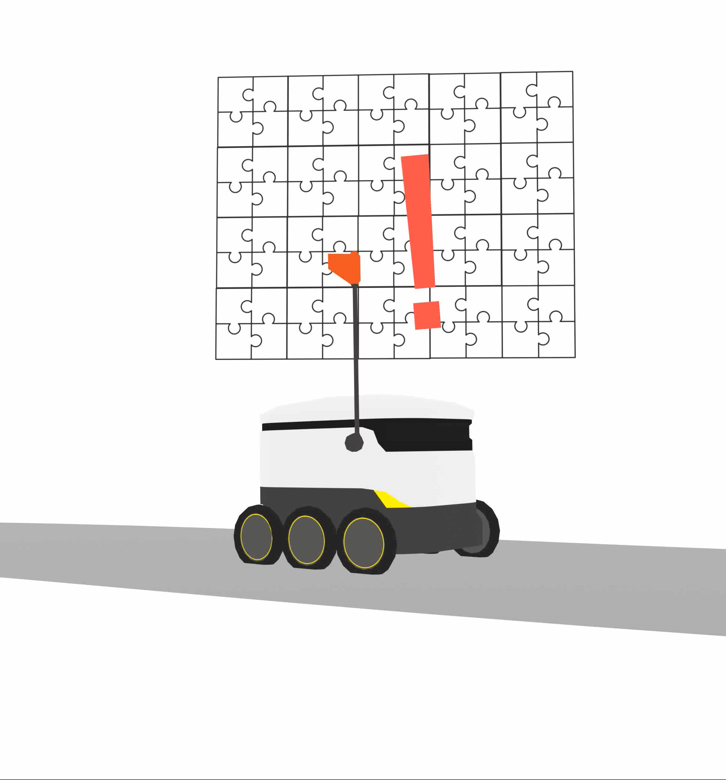
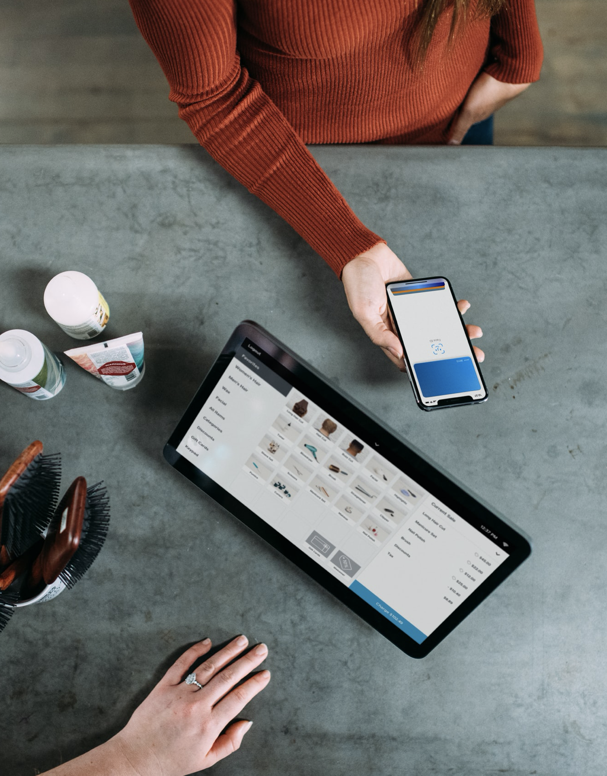
Our Approach
24
Break a map into pieces or a grid

Slide 12
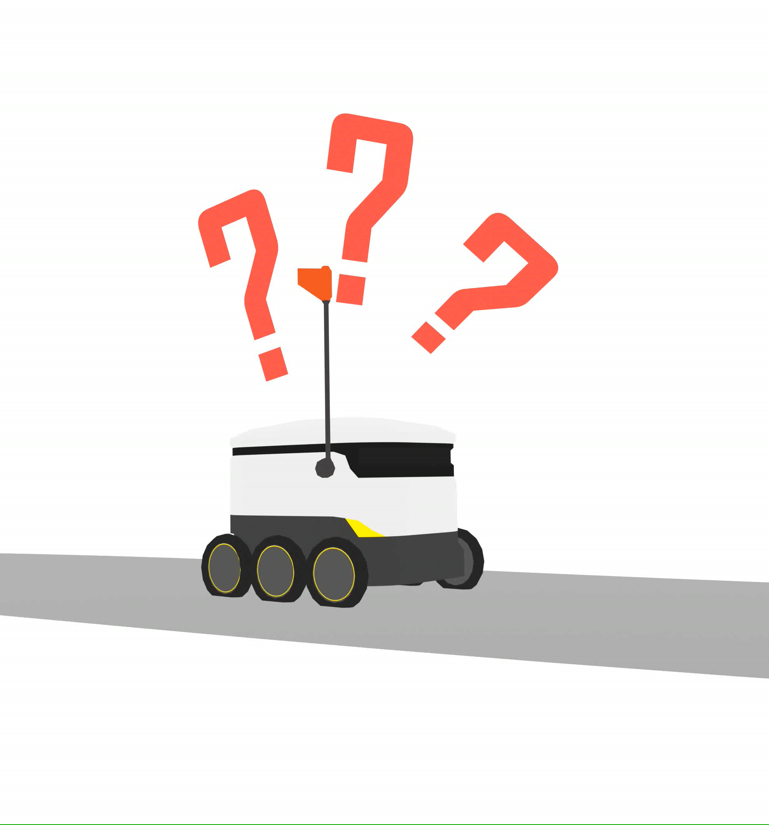
Their Approach
23

Slide 13
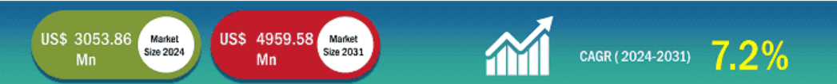
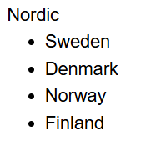
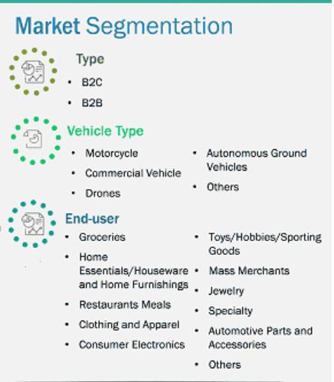
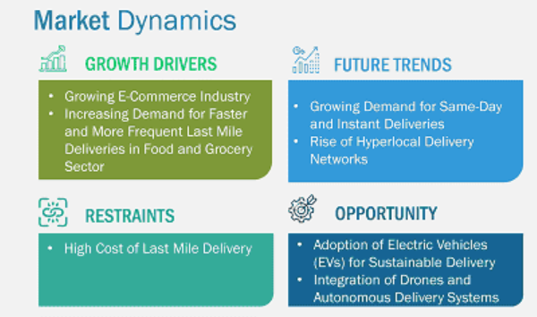
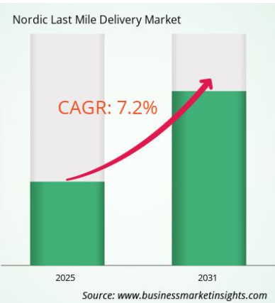
Market size
19
Notes:
Autonomous Delivery Robots Market is expected to grow at a 43.0% CAGR during the forecast period for 2025-2034. https://www.precedenceresearch.com/last-mile-delivery-transportation-market?utm_source=chatgpt.com TAM / SAM / SOM breakdown for autonomous delivery bots, with all figures for 2024 and citations to market‐research reports:
TierDefinition2024 ValueSourceTAM (Total Addressable Market)Global last-mile delivery transportation market—the full spend on getting goods from hub to doorUSD 169.95 billionPrecedence ResearchSAM (Serviceable Available Market)Portion addressable by autonomous delivery robots globallyUSD 20.52 billionFortune Business InsightsSOM (Serviceable Obtainable Market)First-wave capture in Sweden (≈37 % of Nordic market) with 10 % robot penetrationUSD 113 millionBusiness Market Insights
How we arrived at SOM
Nordic last-mile market (Denmark, Finland, Norway, Sweden): USD 3.05 billion in 2024 Business Market Insights
Sweden’s share ≈ 37 % of Nordic (10 M / 27 M population) ⇒ USD 1.13 billion
Initial robot penetration target of 10 % ⇒ USD 113 million serviceable in pilot & early roll-out
By showing a USD 169 B ceiling (TAM), a USD 20.5 B robot-specific segment (SAM), and a clearly-defined SEK 1.1 B (~USD 113 M) launch-phase target (SOM), you give investors a transparent, data-backed growth roadmap.
What is the CAGR for Nordic Last Mile Delivery Market by (2025 - 2031)?
As per our report Nordic Last Mile Delivery Market, the market size is valued at US$ 3053.86 Million in 2024, projecting it to reach US$ 4959.58 Million by 2031. This translates to a CAGR of approximately 7.2% during the forecast period.
How big is the Nordic Last Mile Delivery Market?
The Nordic Last Mile Delivery Market is valued at US$ 3053.86 Million in 2024, it is projected to reach US$ 4959.58 Million by 2031.
1. CAGR Defined
The Compound Annual Growth Rate (CAGR) is the constant annual rate at which a market (or investment) would grow if it expanded smoothly over a period—“smoothing out” year-to-year volatility into a single percentage Investopedia.
Formula:
\text{CAGR} = \Bigl(\tfrac{\text{Ending Value}}{\text{Beginning Value}}\Bigr)^{\frac{1}{\text{# of Years}}} - 1 2. What 43 % CAGR Implies Numerically
Time span: 2025 → 2034 is 9 years.
Growth multiple:
(1+0.43)9≈1.439≈37× (1 + 0.43)^{9} \approx 1.43^{9} \approx 37\times(1+0.43)9≈1.439≈37× So a market worth, say, USD 100 million in 2025 would grow to roughly USD 3.7 billion by 2034.
Doubling time: “Rule of 72” gives doubling ≈ 72 / 43 ≈ 1.7 years.
Every ~1.7 years the market size doubles.
3. Why Such Rapid Growth?
E-commerce acceleration
Online grocery & retail orders are surging, especially for contactless last-mile solutions.
Cost pressures
Retailers seek to cut the 50 %+ share of shipping costs in the last mile—robots deliver at 70–80 % lower cost per trip.
Technology maturation
Advances in AI-vision, edge computing, and battery efficiency now make sidewalk-navigating robots practical and reliable.
Regulatory tailwinds
Cities (especially in Europe) are incentivizing zero-emission logistics, opening sidewalks and bike-lanes to ADRs.
Sustainability mandates
A 98 % drop in CO₂ per mile (vs. vans) aligns ADRs with corporate ESG targets and green-logistics grants.
4. Investor Takeaways
High upside: A 37× market expansion in under a decade.
Rapid adoption cycle: Doubling every ~1.7 years means early entrants can capture large share.
De-risked by grants & pilots: Swedish R&D subsidies (Vinnova, Almi) and successful Trollhättan pilot will accelerate you ahead of the curve.
By understanding CAGR, you see that a 43 % annual growth rate isn’t just a buzz-word—it translates into an explosive market opportunity for Autonomous Delivery Robots.

Slide 14
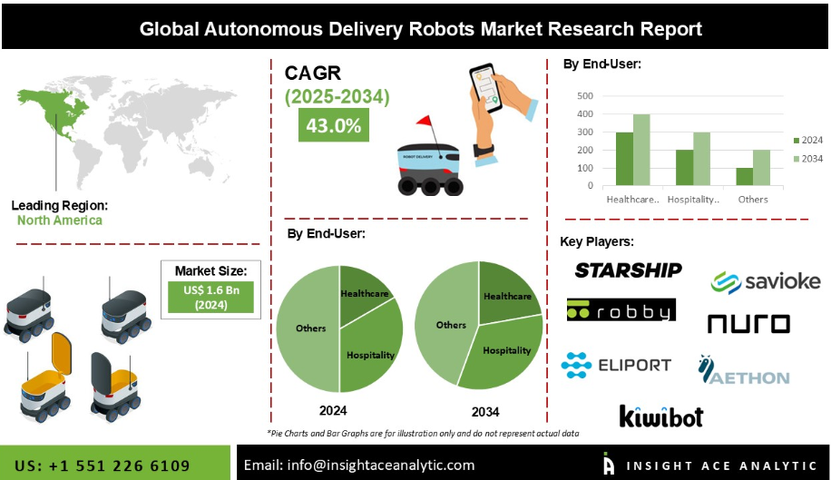
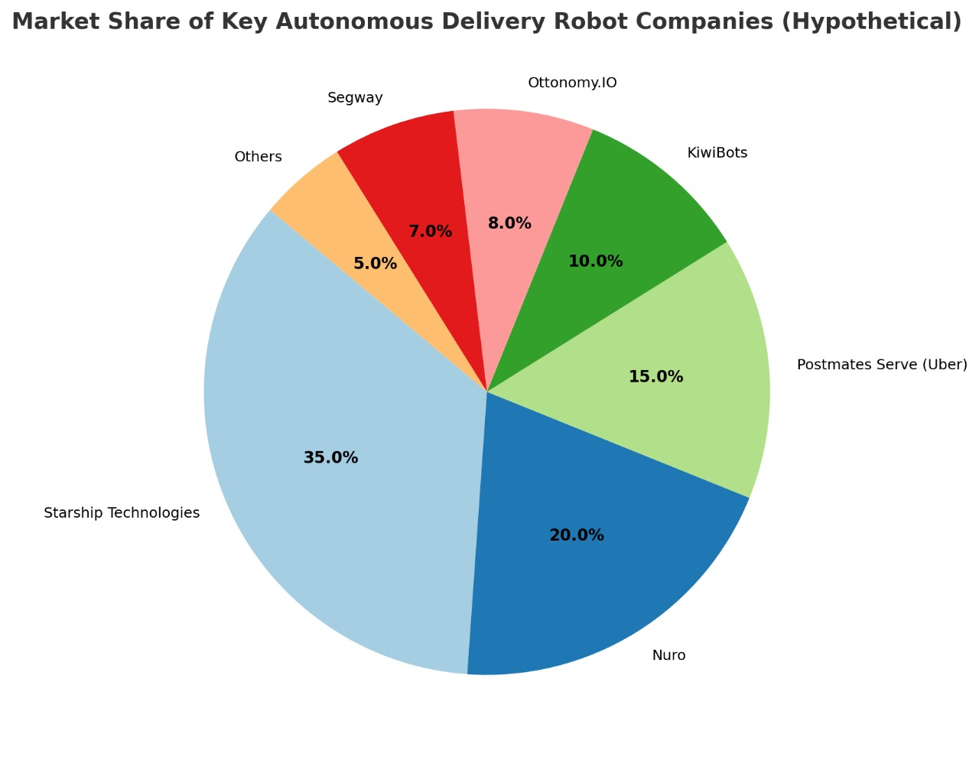
Market size
19
$500M
$200M
$15M
TOTAL
AVAILABLE MARKET
SERVICEABLE
AVAILABLE MARKET
SERVICEABLE OBTAINABLE MARKET
Notes:
Autonomous Delivery Robots Market is expected to grow at a 43.0% CAGR during the forecast period for 2025-2034. https://www.precedenceresearch.com/last-mile-delivery-transportation-market?utm_source=chatgpt.com TAM / SAM / SOM breakdown for autonomous delivery bots, with all figures for 2024 and citations to market‐research reports:
TierDefinition2024 ValueSourceTAM (Total Addressable Market)Global last-mile delivery transportation market—the full spend on getting goods from hub to doorUSD 169.95 billionPrecedence ResearchSAM (Serviceable Available Market)Portion addressable by autonomous delivery robots globallyUSD 20.52 billionFortune Business InsightsSOM (Serviceable Obtainable Market)First-wave capture in Sweden (≈37 % of Nordic market) with 10 % robot penetrationUSD 113 millionBusiness Market Insights
How we arrived at SOM
Nordic last-mile market (Denmark, Finland, Norway, Sweden): USD 3.05 billion in 2024 Business Market Insights
Sweden’s share ≈ 37 % of Nordic (10 M / 27 M population) ⇒ USD 1.13 billion
Initial robot penetration target of 10 % ⇒ USD 113 million serviceable in pilot & early roll-out
By showing a USD 169 B ceiling (TAM), a USD 20.5 B robot-specific segment (SAM), and a clearly-defined SEK 1.1 B (~USD 113 M) launch-phase target (SOM), you give investors a transparent, data-backed growth roadmap.
What is the CAGR for Nordic Last Mile Delivery Market by (2025 - 2031)?
As per our report Nordic Last Mile Delivery Market, the market size is valued at US$ 3053.86 Million in 2024, projecting it to reach US$ 4959.58 Million by 2031. This translates to a CAGR of approximately 7.2% during the forecast period.

Slide 15
Timeline
26
1
2
3
Prep & Grant Filing
Design & Detailed Engineering
Hardware Build & Bench Testing
Mar-May 2025
Apr-May 2025
May-Sep 2025
4
5
6
Regulatory Certification
Pilot Setup & Execution
Data Analysis & Optimization
July-Dec 2025
Dec-Mar 2026
Apr-May 2026
7
8
9
Commercial Launch
Scale Manufacturing
Fleet Management
Jun-Sep 2026
Aug-Dec 2026
Oct 2026
10
11
12
National Expansion
International Pilot Prep
Nordic Roll Out
Jan 2027-Dec 2027
2028
2029

Slide 16

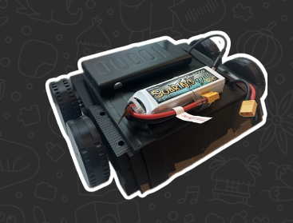
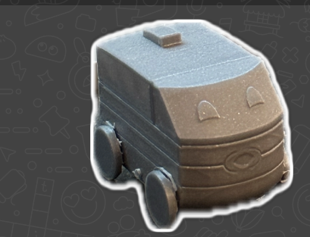
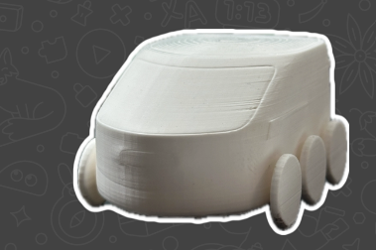
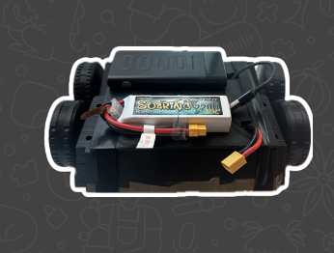
Demo & Discussion

Slide 17
3
Founding Team
Deepak A Bellikatti
Prajwal M Palled
M V S Aditya
Specialization:
Manufacturing and Design
Chief Operations Officer; COO
Specialization:
Electronic and Communication Design
Chief Technical Officer; CTO
Specialization:
Design and Rapid Prototyping
Chief Innovation Officer; CINO
Zainab Fatima Bokhari
Specialization:
Business and Operations
Chief Executive Officer; CEO
Notes:
COO: Day-to-day operations and execution
CTO: Technology strategy and R&D
CINO: Innovation pipeline and new ventures
CEO: Overall business strategy, vision, and leadership

Slide 18
“Technology is not just about innovation, it's about creating a future where progress and sustainability go hand in hand.”

